Slide 1
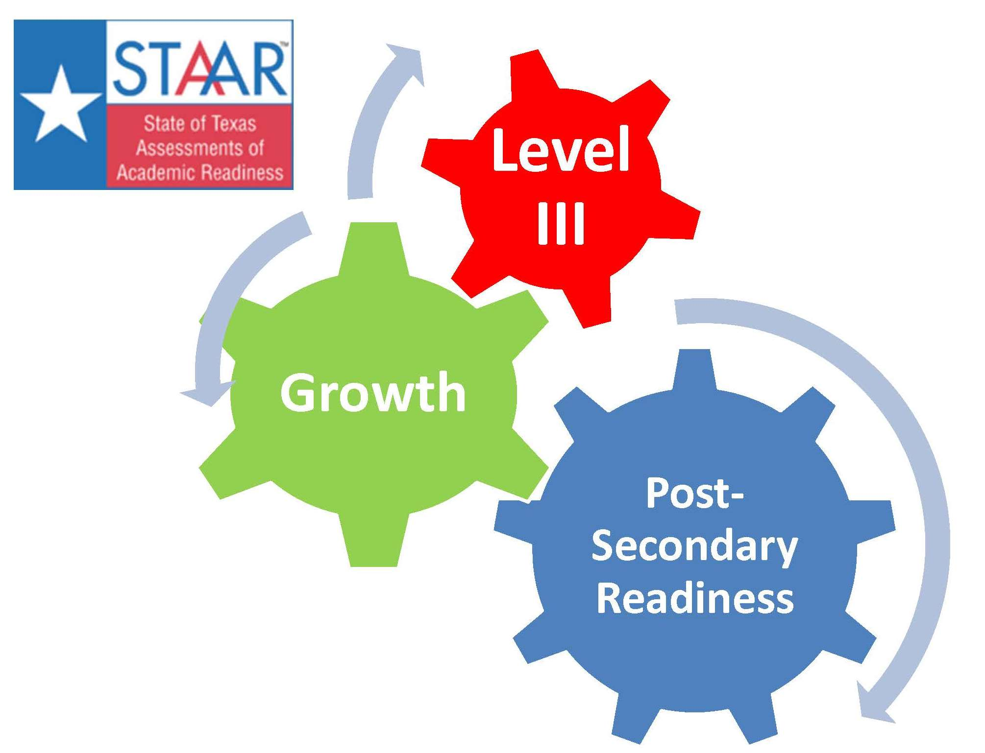
Accountability to Responsibility in a
STAAR World!
Shauna Lane, ESC Specialist --slane@esc17.net
Ty Duncan, ESC 17 Coordinator --tduncan@esc17.net

Slide 2



Follow us on Twitter:
@instructionalle
@esc17ace
@esc17counselors
Like our Facebook Wall for Live Updates!!
https://www.facebook.com/pages/Region-17-Instructional-Leaders/204792002878635

Slide 3
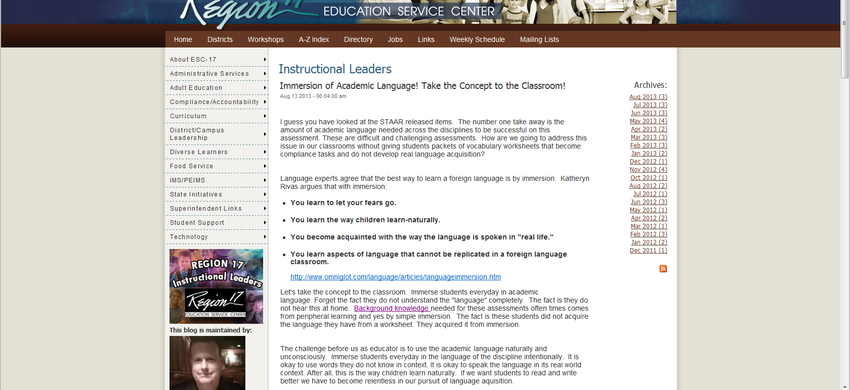
Take a Look at Our Blog!!
http://www.esc17.net/default.aspx?name=blog.instructionalleaders

Slide 4
Session Objectives
This session will:
Detail the implications of the Accountability System as we move forward in Texas.
Explore both the procedural and cultural implications of STAAR on our districts and campuses as well as look at practical ways to ensure campus and districts ensure they are meeting student needs while also meeting the goals intended goals of the accountability system in Texas.
Challenge us to meet our responsibility to the students we serve while working within the confines of a sophisticated accountability system.
Come prepared to look at data and research that will influence your culture in a positive way.

Slide 5
Accountability vs. Responsibility
What drives us to the right thing?
Is the Accountability System the driver?
Would we do the right thing if the Accountability system did not exist?

Slide 6
Index 1: Student Achievement
Index 1 Student Achievement provides an overview of student performance based on satisfactory student achievement across all subjects for all students.
Subjects: Combined over Reading, Mathematics, Writing, Science, and Social Studies.
Student Groups: All Students only
Performance Standards: Phase-in 1 Level II (Satisfactory)

Slide 7

Pass/Fail Culture

Slide 8
Phase-in Level - Met Satisfactory
Subject |  | Phase 1 | Phase 2 | Final
Reading | Grade 3 | 50% | 65% | 75%
 | Grade 4 | 55% | 66% | 77%
 | Grade 5 | 57% | 67% | 78%
 | Grade 6 | 56% | 67% | 77%
 | Grade 7 | 54% | 66% | 76%
 | Grade 8 | 54% | 65% | 75%
Math | Grade 3 | 59% | 72% | 83%
 | Grade 4 | 60% | 73% | 81%
 | Grade 5 | 54% | 66% | 78%
 | Grade 6 | 42% | 58% | 71%
 | Grade 7 | 43% | 56% | 67%
 | Grade 8 | 39% | 52% | 63%
Science | Grade 5 | 59% | 70% | 80%
 | Grade 8 | 52% | 63% | 72%
Social Studies | Grade 8 | 50% | 62% | 73%
Writing | Grade 4 | 52% | 61% | 68%
 | Grade 7 | 56% | 64% | 72%

Slide 9
Phase-in Level - Met Satisfactory
Subject |  | Phase 1 | Phase 2 | Final
Reading | English I Reading | 54% | 61% | 66%
 | English II Reading | 54% | 59% | 63%
 | English I Writing | 63% | 68% | 71%
 | English II Writing | 68% | 73% | 76%
Math | Algebra I | 37% | 50% | 63%
Science | Biology | 37% | 48% | 61%
Social Studies | U.S. History | 41% | 53% | 65%

Slide 10
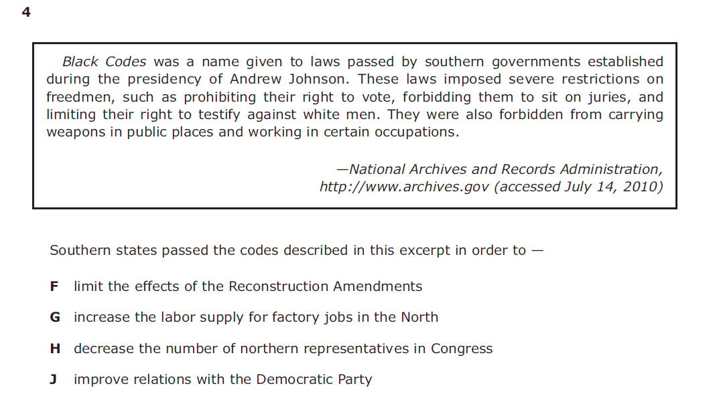

Raising the Instructional Bar!

Slide 11
The Structure of Knowledge
Principle
Generalization
Concept
Concept
Topic
Topic
FACTS
FACTS
FACTS
FACTS
FACTS
FACTS
FACTS
FACTS
Lynn Erickson -- Concept-Based Curriculum and Instruction for the Thinking Classroom, 2007

Slide 12
Connecting Topics
Raising the Instructional Bar!
Manifest Destiny
Colonization
New Nation
Civil War
Revolution
1607
1776
1787
1803
1861-1865

Slide 13
Raising the Instructional Bar!
Expansion--- Democracy --- Conflict --- Culture--- Industrialization
Manifest Destiny
Colonization
New Nation
Civil War
Revolution
1607
1776
1787
1803
1861-1865

Slide 14
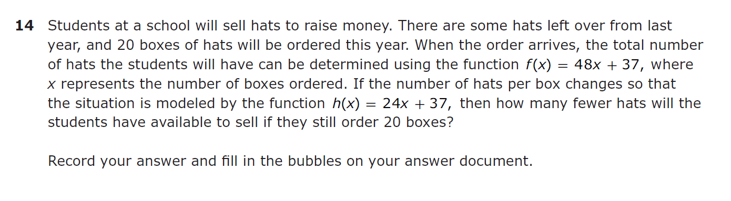
Academic Vocabulary Immersion
http://www.esc17.net/default.aspx?name=blog.instructionalleaders&from=8/1/2013&to=8/31/2013

Slide 15
Index 2: Student Progress
Index 2: Student Progress focuses on actual student growth independent of overall achievement levels for each race/ethnicity student group, students with disabilities, and English language learners.
By Subject Area: Reading, Mathematics, and Writing for available grades.
Credit based on weighted performance:
  One point credit given for each percentage of students at the Met growth expectations level.
  Two point credit given for each percentage of students at the Exceeded growth expectations level.

Slide 16
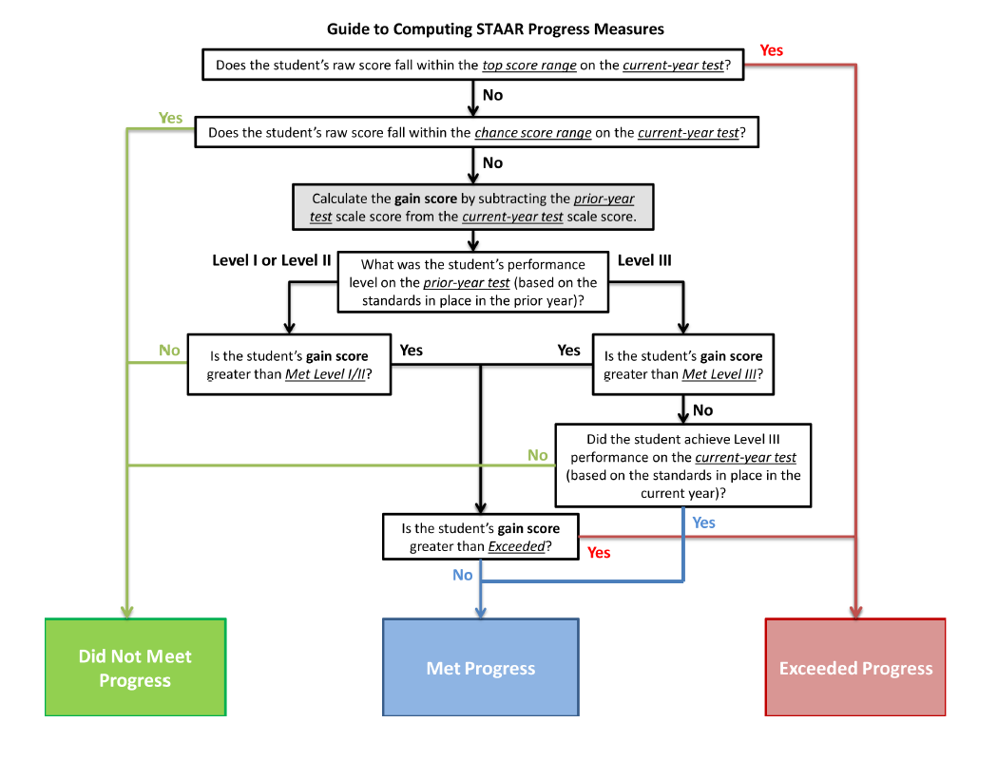
Index 2: Student Progress

Slide 17
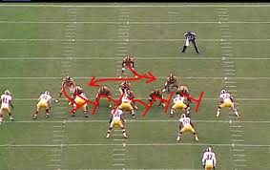
Maybe the Coaches Have It Right!
They do not wait till the season is over analyze game film because that would not be responsive enough.
Formative assessment is
the only way to really
grow students!
Benchmarks are fine, but in the end they are not responsive enough. Be responsive!
http://www.esc17.net/default.aspx?name=blog.instructionalleaders&from=4/1/2013&to=4/30/2013

Slide 18
Index 3: Closing Performance Gaps
Index 3: Closing Performance Gaps emphasizes advanced academic achievement of economically disadvantaged students and the two lowest performing race/ethnicity student groups.
Credit based on weighted performance:
  Phase-in Level II satisfactory performance (2013 and beyond)
  One point for each percent of students at the phase-in Level II satisfactory performance standard.
  Level III advanced performance (2014 and beyond)
  Two points for each percent of students at the Level III advanced performance standard.
The STAAR weighted performance rate calculation must be modified for 2013 because STAAR Level III advanced performance cannot be included in the indicator until 2014.

Slide 19
Index 3: Closing Performance Gaps
By Subject Area: Reading, Mathematics, Writing, Science, and Social Studies.
Student Groups
Socioeconomic: Economically Disadvantaged
Lowest Performing Race/Ethnicity: The two lowest performing race/
ethnicity student groups on the campus or district (based on
prior-year assessment results).

Slide 20

Measure The Standard
Not “The Work”
5) History. The student understands the challenges confronted by the government and its leaders in the early years of the republic and the Age of Jackson. The student is expected to:
(E) identify the foreign policies of presidents Washington through Monroe and explain the impact of Washington's Farewell Address and the Monroe Doctrine;
Does a student who matches the people found in (E)on a worksheet deserve a hundred in the grade book?
How do you define FULL KNOWLEDGE of the student expectation above?

Slide 21
Index 4: Postsecondary Readiness
Index 4: Postsecondary Readiness emphasizes the importance for students to receive a high school diploma that provides them with the foundation necessary for success in college, the workforce, job training programs, or the military; and the role of elementary and middle schools in preparing students for high school.
Graduation Score: Combined performance across the graduation and dropout rates for
Grade 9-12 Four-Year Graduation Rate for All Students and all student groups OR
Grade 9-12 Five-Year Graduation Rate for All Students and all student groups, whichever contributes the higher number of points to the index.
RHSP/AHSP Graduates for All Students and race/ethnicity student groups
STAAR Score: STAAR Percent Met Final Level II on One or More Tests for All Students and race/ethnicity student groups (2014 and beyond)

Slide 22
Index 4: Postsecondary Readiness
Index 4: Postsecondary Readiness
STAAR Level II Performance for Index 4
In 2014 and beyond, credit will be given for final Level II performance on the same assessments used in Index 1 at final Level III performance standard.
Subjects Areas Evaluated for STAAR Performance in Index 4
All subject areas (reading, mathematics, writing, science, and social studies) are combined. Subject areas are not evaluated separately.
Student Groups Evaluated for STAAR Performance in Index 4
Eight student groups are evaluated. All Students and the Seven Racial/Ethnic groups: African American, American Indian, Asian, Hispanic, Pacific Islander, White, and Two or More Races
How this is evaluated is yet to be determined by APAC and ATAC

Slide 23

Stop Talking About Differentiation and Do It At the Secondary Level!!
Identify Presidents foreign policy?
Student Expectation:
(E) identify the foreign policies of presidents Washington through Monroe and explain the impact of Washington's Farewell Address and the Monroe Doctrine;
Read the Farewell Address and Monroe Doctrine and compare their application?
Debate the foreign policy that would best suit current political tensions in Syria!
Take a look at Roosevelt’s Corollary to the Monroe Doctrine. Is it necessary? Why would Washington argue against it?

Slide 24
Level III is Not That Far Away!!

Slide 25
Accountability vs. Responsibility
What is Responsible?
  Raising the Bar!!
  Vocabulary Immersion
  Increase Responsiveness
  Measure Standard and Not “the Work”
  Differentiate to Level III

Slide 26
Follow us on Twitter:
@instructionalle
@esc17ace
@esc17counselors
Like our Facebook Wall for Live Updates!!
https://www.facebook.com/pages/Region-17-Instructional-Leaders/204792002878635

Slide 27
Take a Look at Our Blog!!
http://www.esc17.net/default.aspx?name=blog.instructionalleaders

Slide 28
Resources
Frequently Asked Questions About Adequate Yearly Progress (AYP)
http://ritter.tea.state.tx.us/ayp/faq/faq.html
Performance Reporting Home Page
http://www.tea.state.tx.us/perfreport
2013 Accountability System Frequently Asked Questions
http://ritter.tea.state.tx.us/perfreport/account/2013/faq.html
TCDSS Summer Collaborative
Lynn Erickson -- Concept-Based Curriculum and Instruction for the Thinking Classroom, 2007

